Slide 1

EMTF pT Training using k-NN
Wei Shi
weishi@rice.edu
CMS@Rice

Slide 2
Introduction
Why are we doing pT training?
EMTF assign pT before global muon trigger(GMT), important for Level 1 trigger to reduce large amount of data in collisions at the LHC
Need precise pT assignment
Why machine learning(ML)?
Muon tracks non-analytic, ML better than humans eye
Why KNN?
Simple, intuitive method for machine learning, tuning parameters is easy

Slide 3
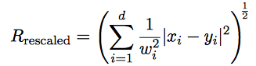
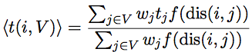
k-nearest-neighbor(KNN)
x: input variables(dimension d) of train event
y: input variables of test event
w_{i}: weight from variable scaling
k: number of nearest neighbors
f: polynomial kernel weight function
w_{j}: weight of j in train sample
t_{j}: train target value
t: test target value
More about k-NN:
http://cs231n.github.io/classification/#nn kd-tree sorting: http://citeseerx.ist.psu.edu/viewdoc/download?doi=10.1.1.160.335&rep=rep1&type=pdf

Slide 4
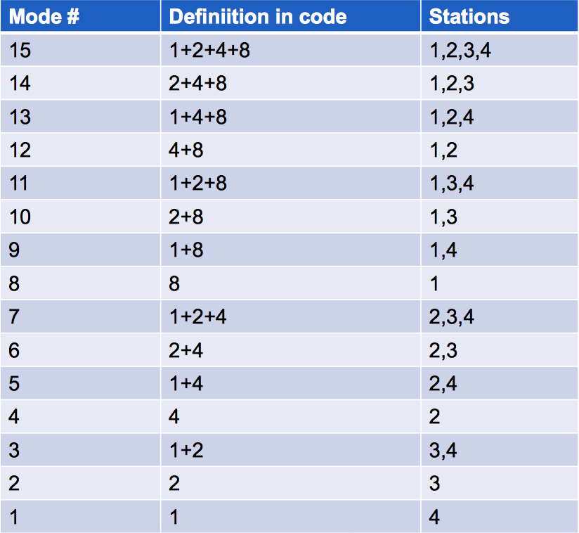
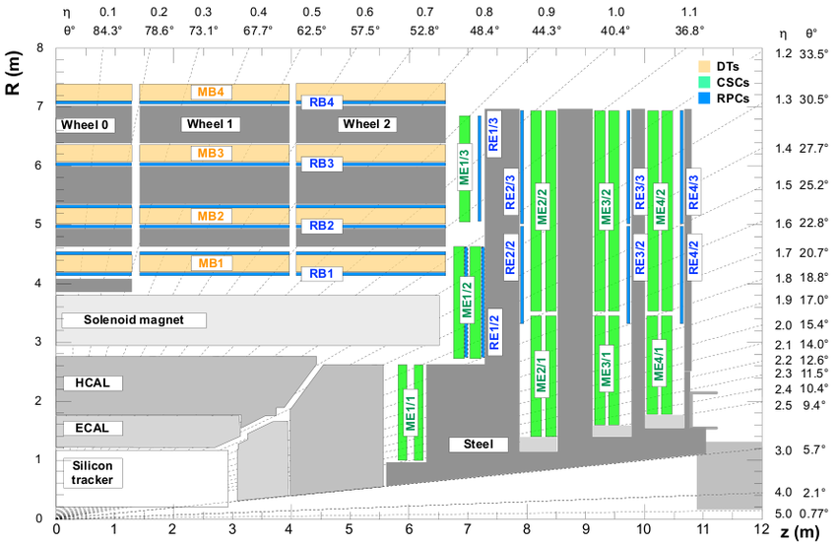
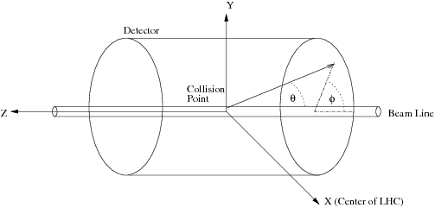
EMTF modes

Slide 5
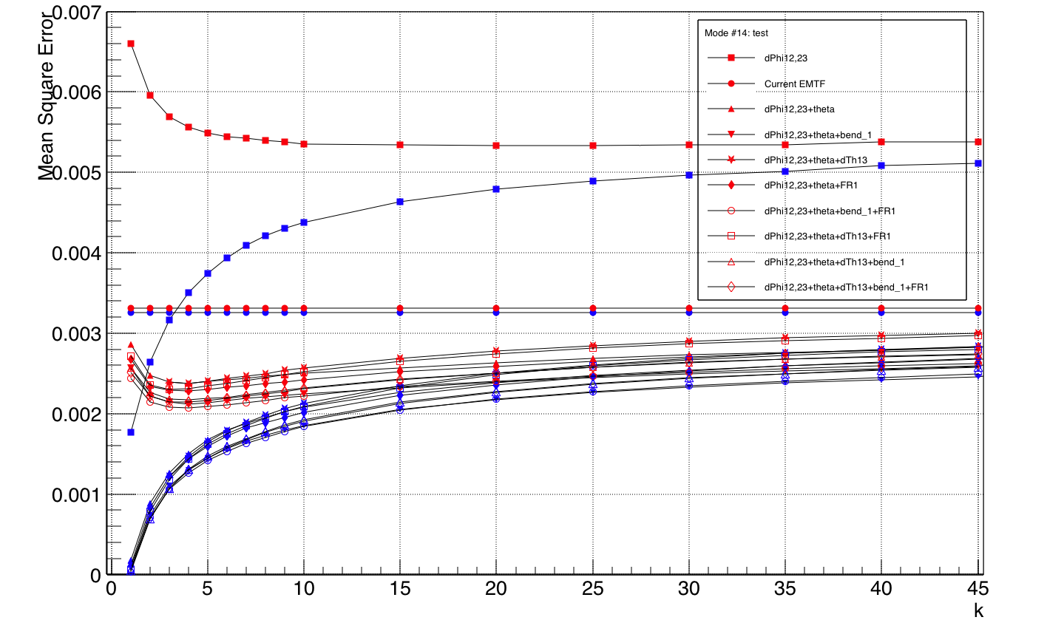
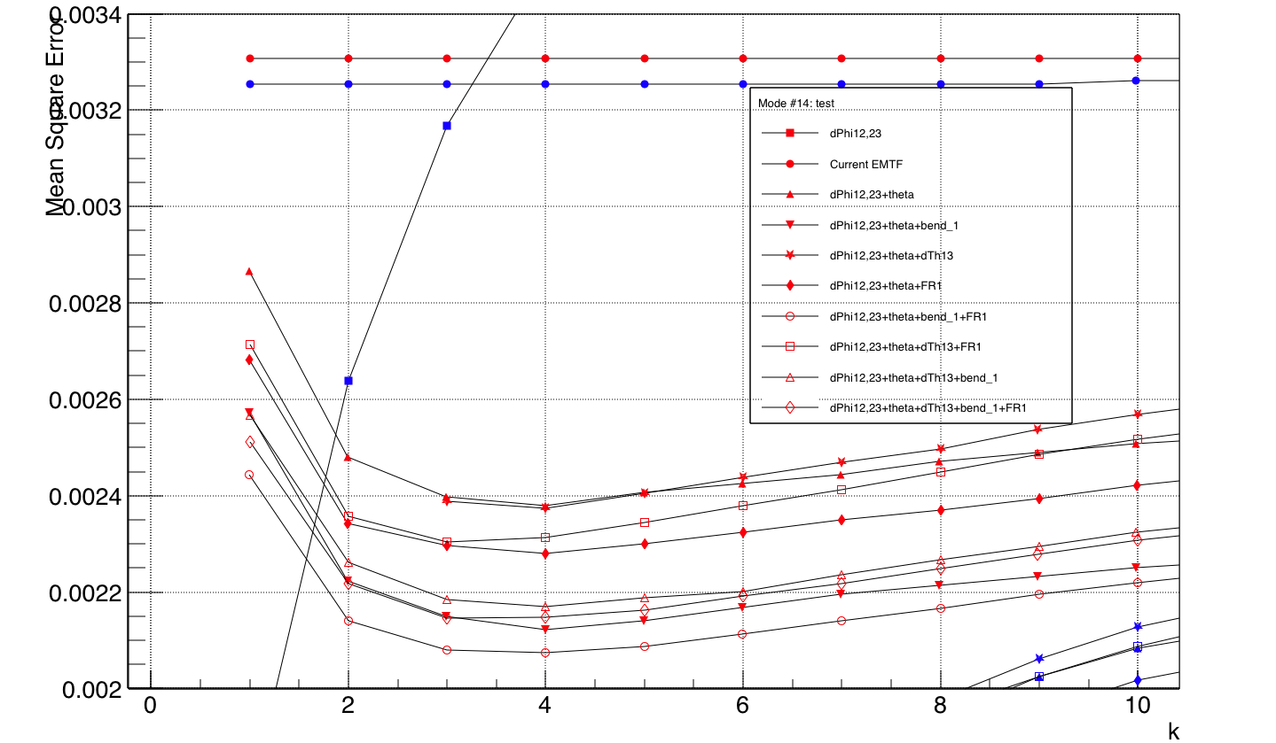
Whole pT range, weighted 1/pT, mode 14
Zoom in of green dash circle in left plot
Add theta: significant drop of Mean Square Error (MSE = (test pT – true pT)^2/# of test events)
dPhis+theta+bend_1+FR1 give best performance on all pT range 1-1000 GeV
Need to look at low/high pT performance separately

Slide 6
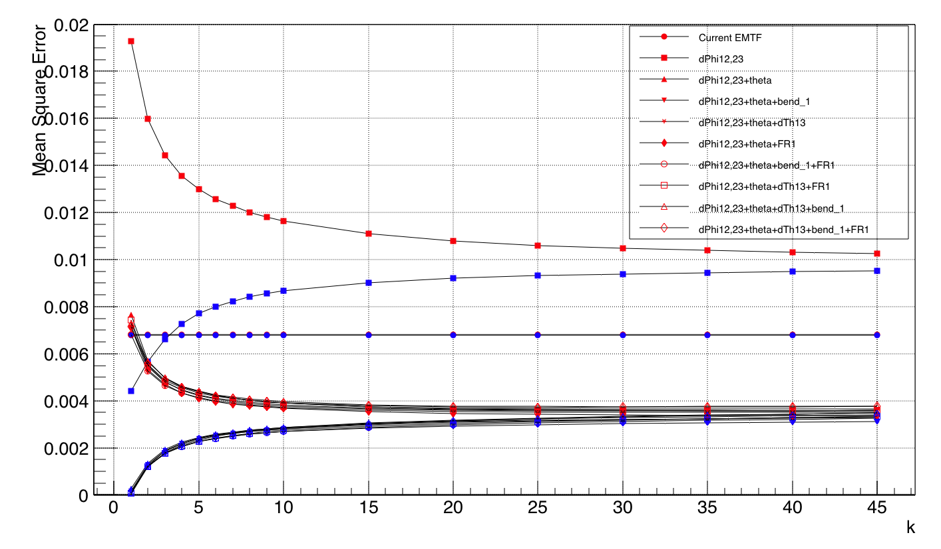
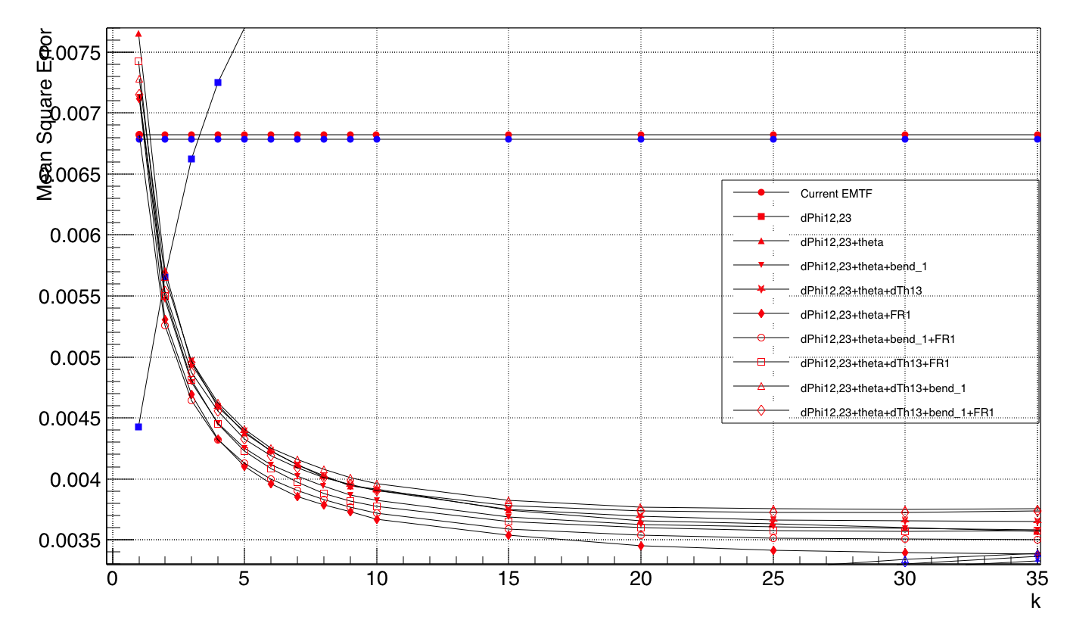
pT 1-8GeV
Zoom in of green dash circle in left plot
Over fit starts when k<10, main contribution to over training in whole pT range plot
Perform better at larger k

Slide 7
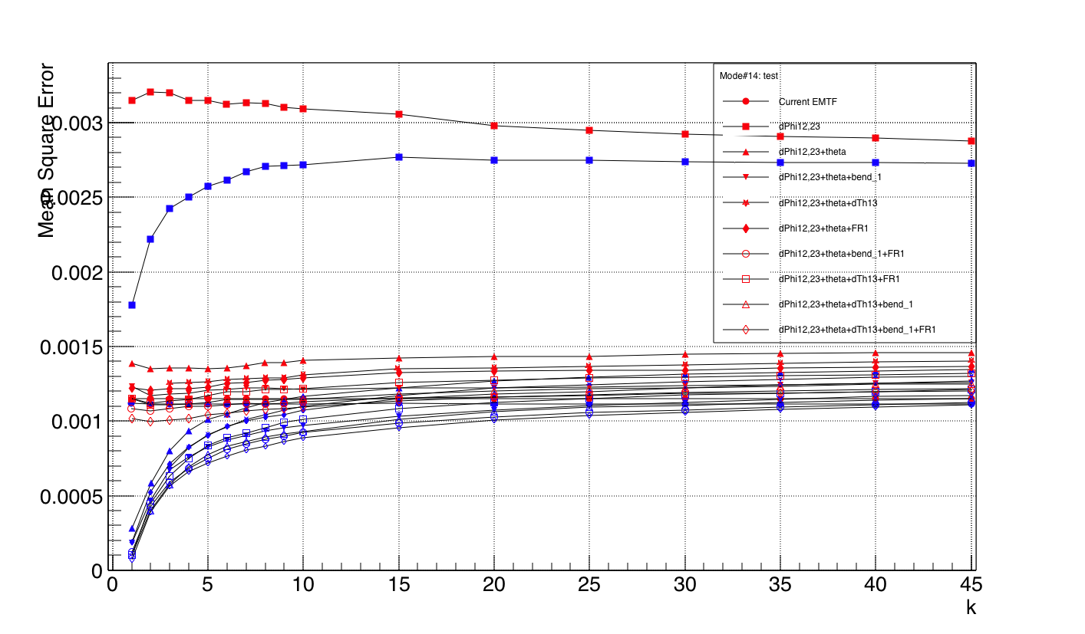
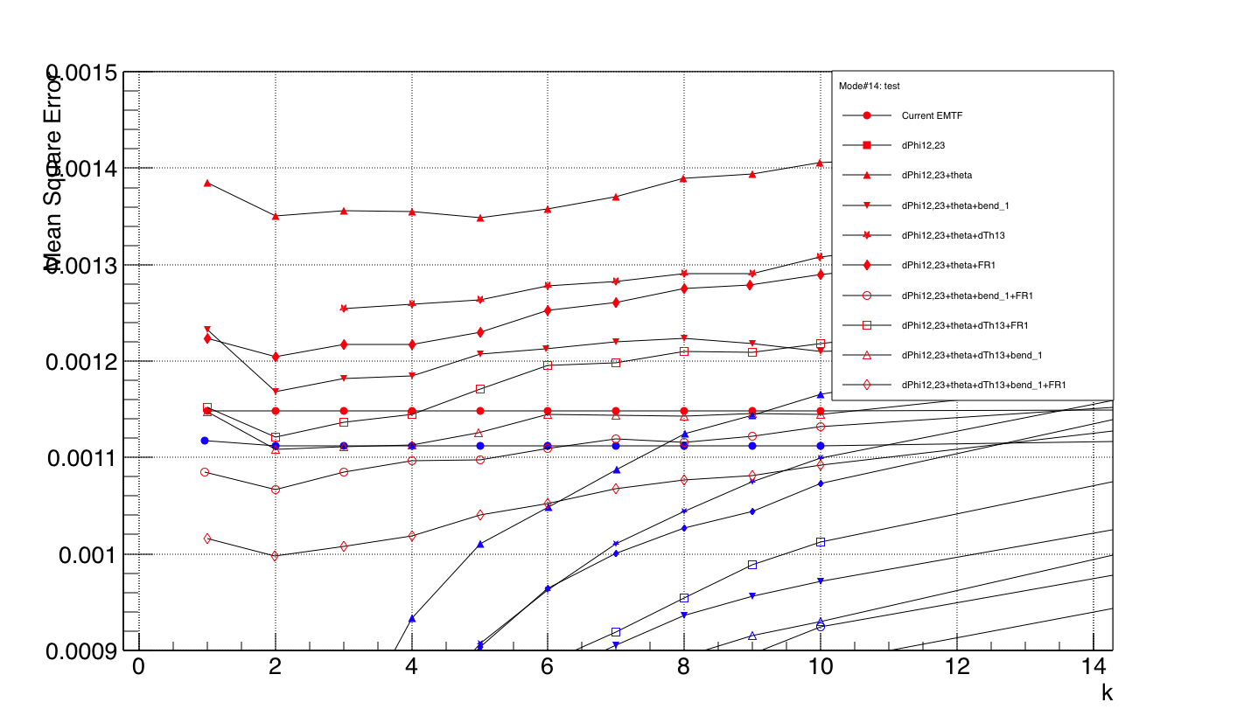
pT 8-30GeV
Zoom in of green dash circle in left plot
MSE minima at very low k

Slide 8
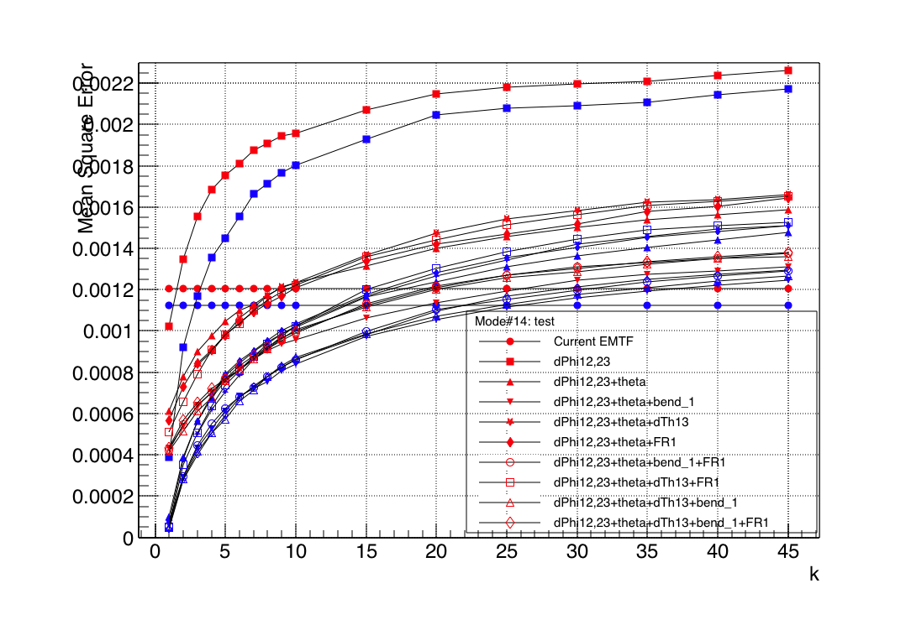
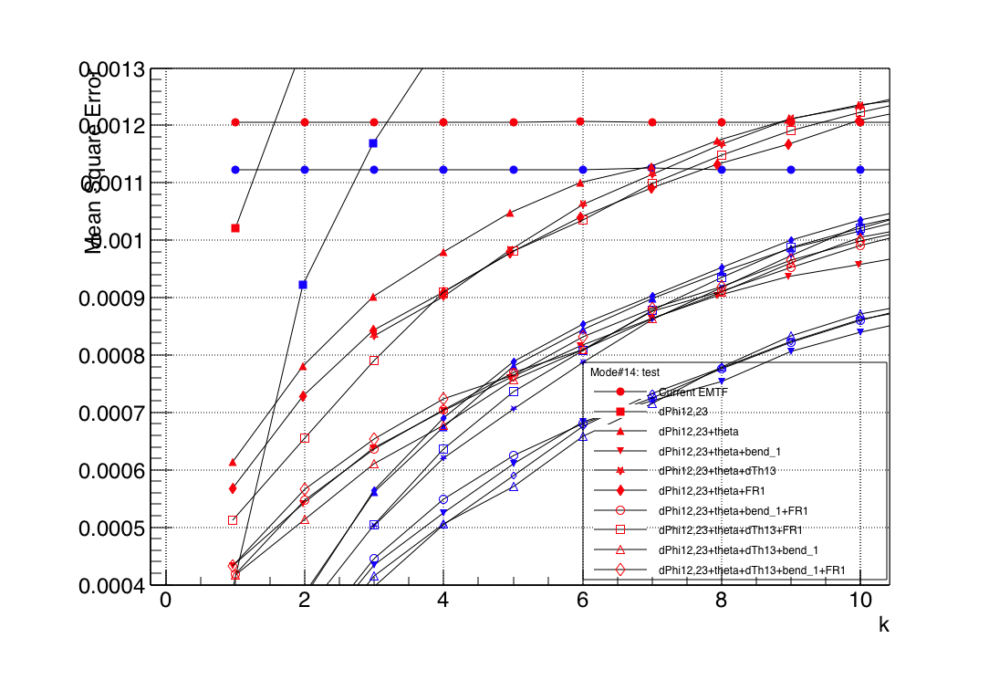
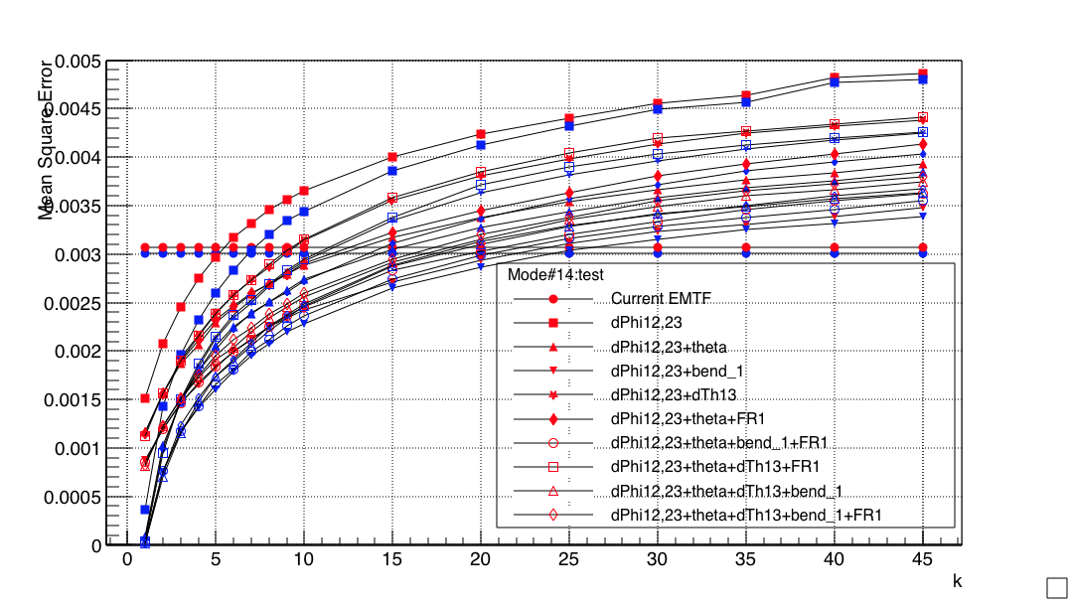
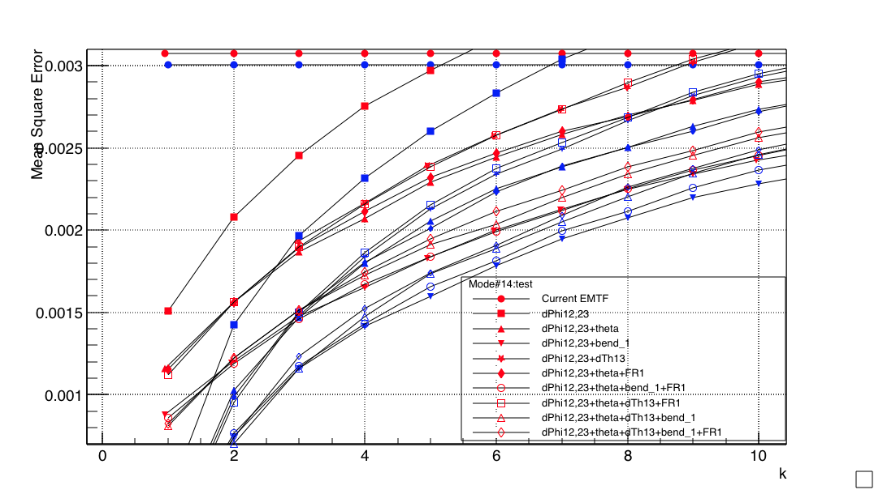
pT 30-120 GeV(upper plots), 120-1000 GeV(lower plots)
High pT favors smaller k

Slide 9
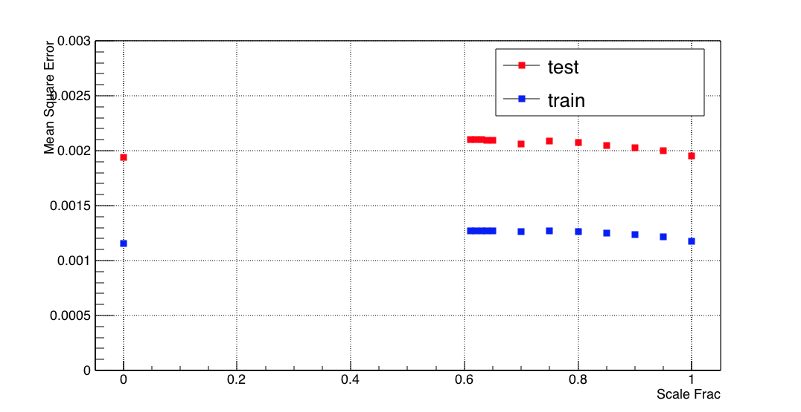
Scale input variables
Input variables have different distribution
e.g. θ has larger distribution than ∆φ
Need to standardize variables when calculating distance
Scale Frac = 1 gives best performance, but no big difference
Scale Frac = 0 means turning off scale
Scale Frac = (0, 0.61), TMVA fails

Slide 10
What we know so far…
Significant improve of MSE when adding theta
As long as theta is added in input variables, MSE won’t change too much
Over training at small k contributed from low pT 1-8GeV, low pT favors larger k
High pT favors smaller k
Standardize input variables won’t change performance much
Choose dPhis+theta+bend_1+FR1, scale frac=1, vary k for new metric: efficiency/rate

Slide 11
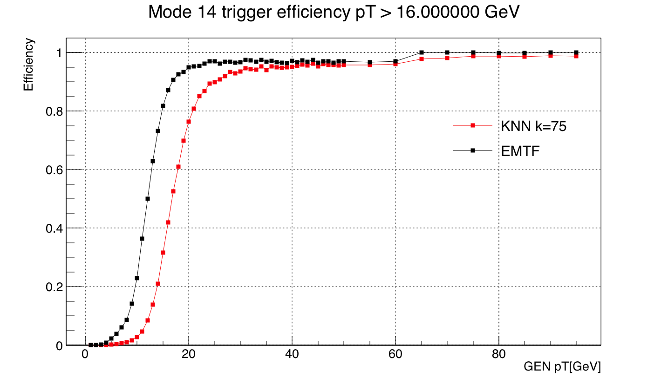
Efficiency on test sample
Efficiency: muons with true pT = X (the “threshold”) are assigned a pT > X by the trigger(KNN/EMTF)

Slide 12
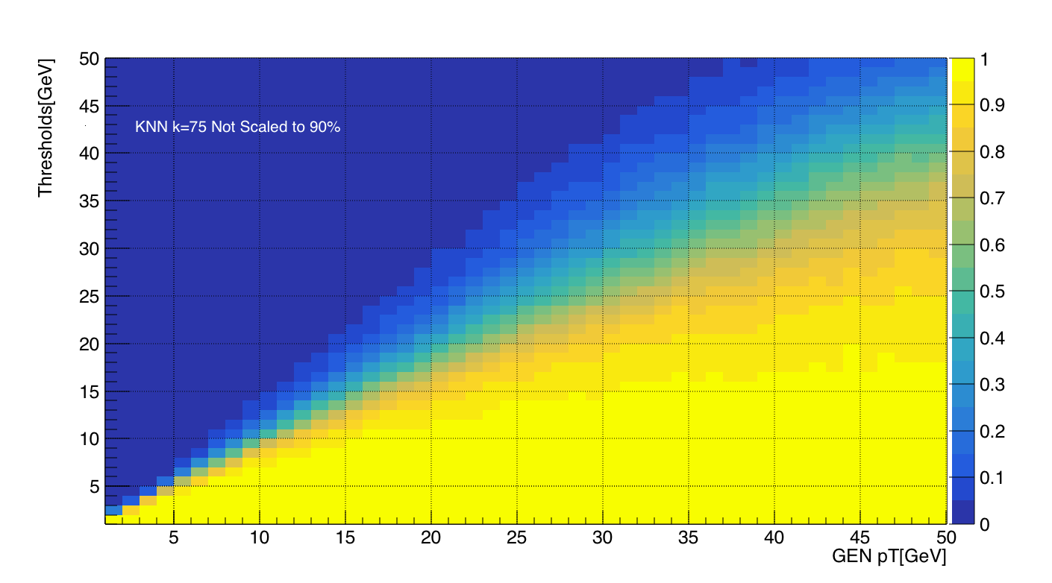
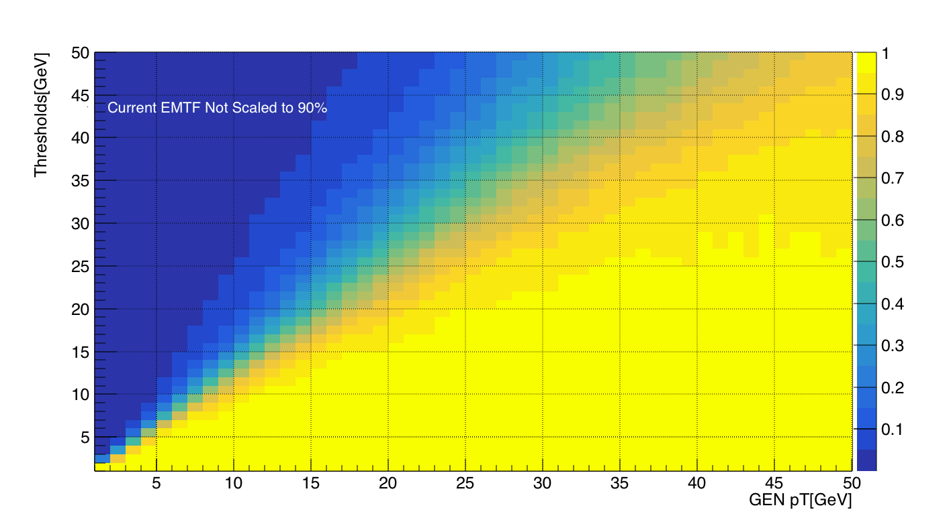
Trigger efficiency(k=75)
KNN (Not scaled)
EMTF(Current was scaled to ~80%)
Acceptable efficiency: 90% at pT=X, 95%-100% at pT>>X, “plateau efficiency”

Slide 13
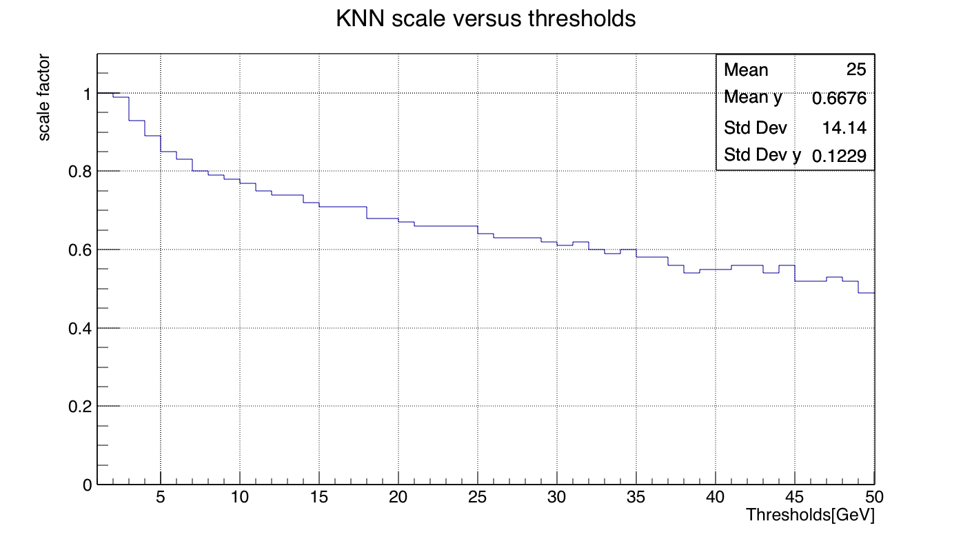
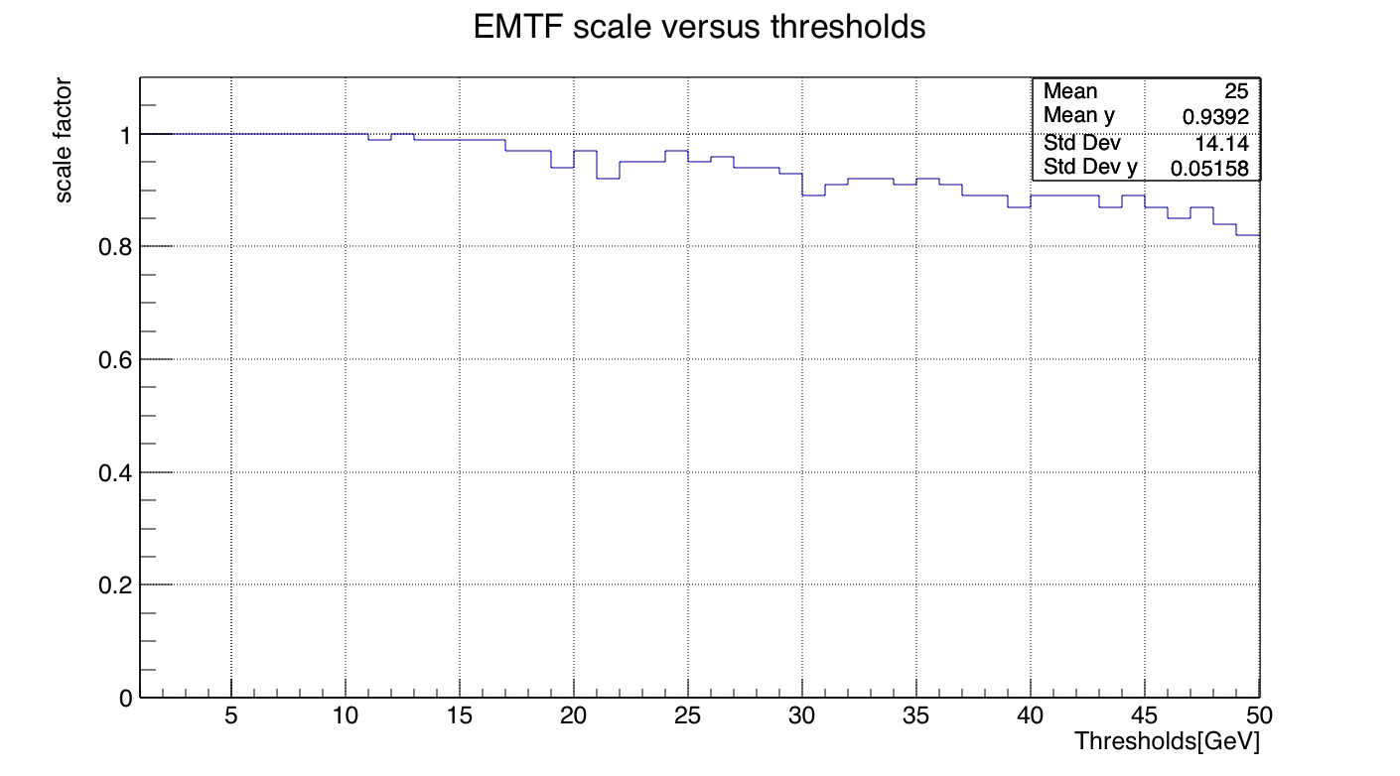
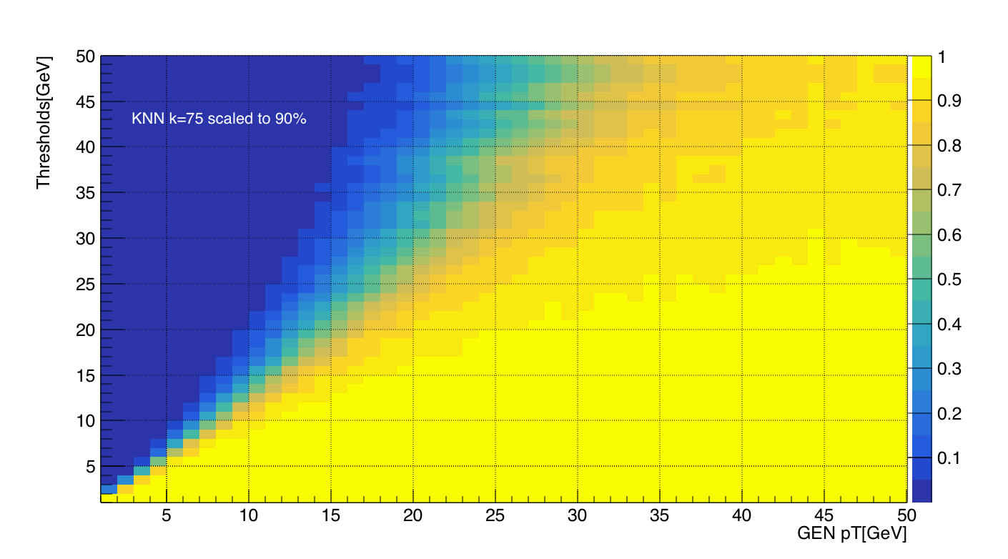
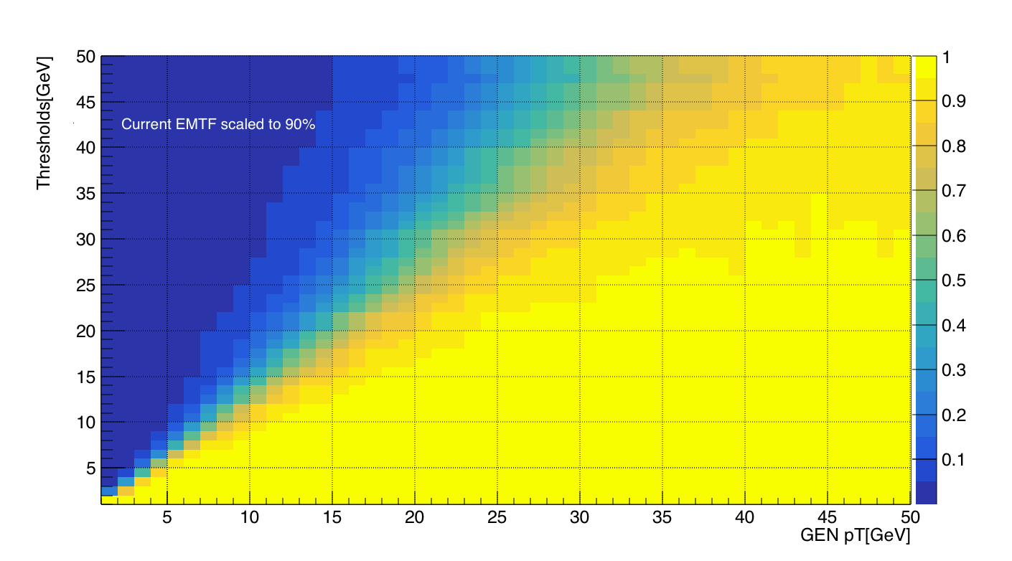
Scale KNN efficiency to 90% at each threshold by multiplying a factor
Trigger efficiency(k=75)
KNN (Scaled)
EMTF(Scaled)

Slide 14
Training & evaluation
SingleMu MC sample for training
Half of the muons below 32GeV, half are above
ZeroBias dataset for evaluation
Average of the true data the trigger will actually see, for muons above 32 GeV, more like 1 - 1 million
Really see hundreds muons above 32 GeV, pT assignment not good without the tracker, low pT assigned high pT
Tell us the true rate of muons for a given pT cut, the lower the better for the same efficiency

Slide 15
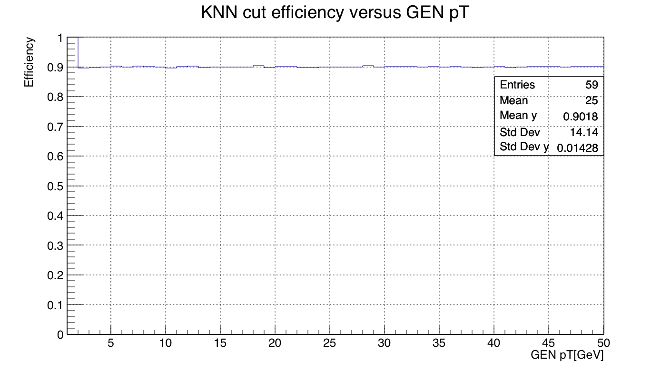
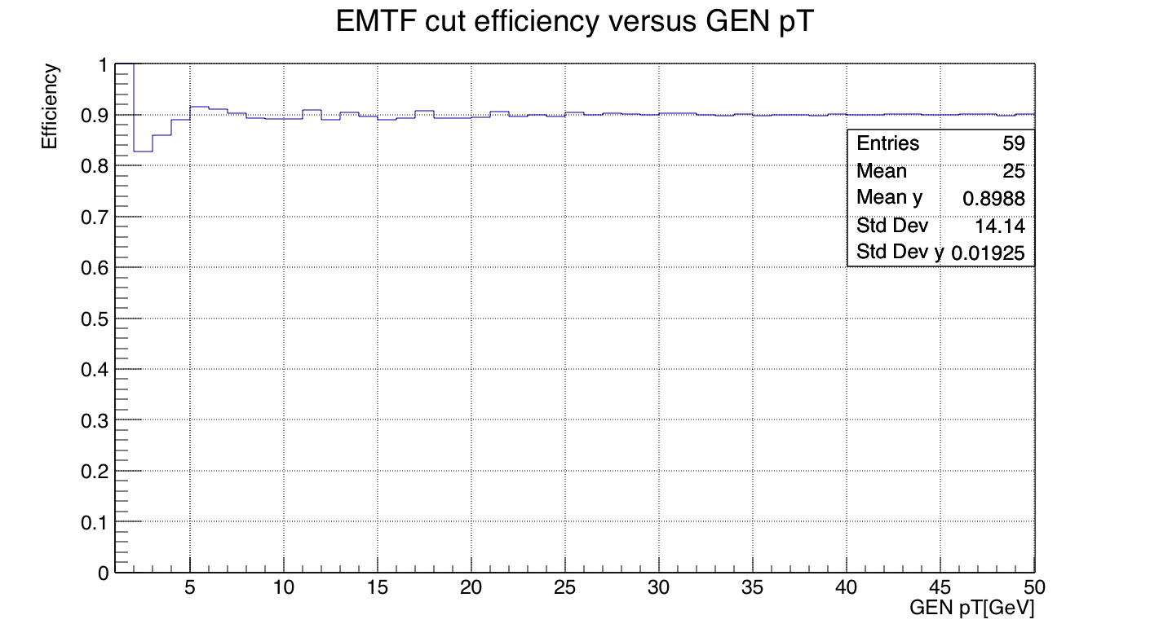
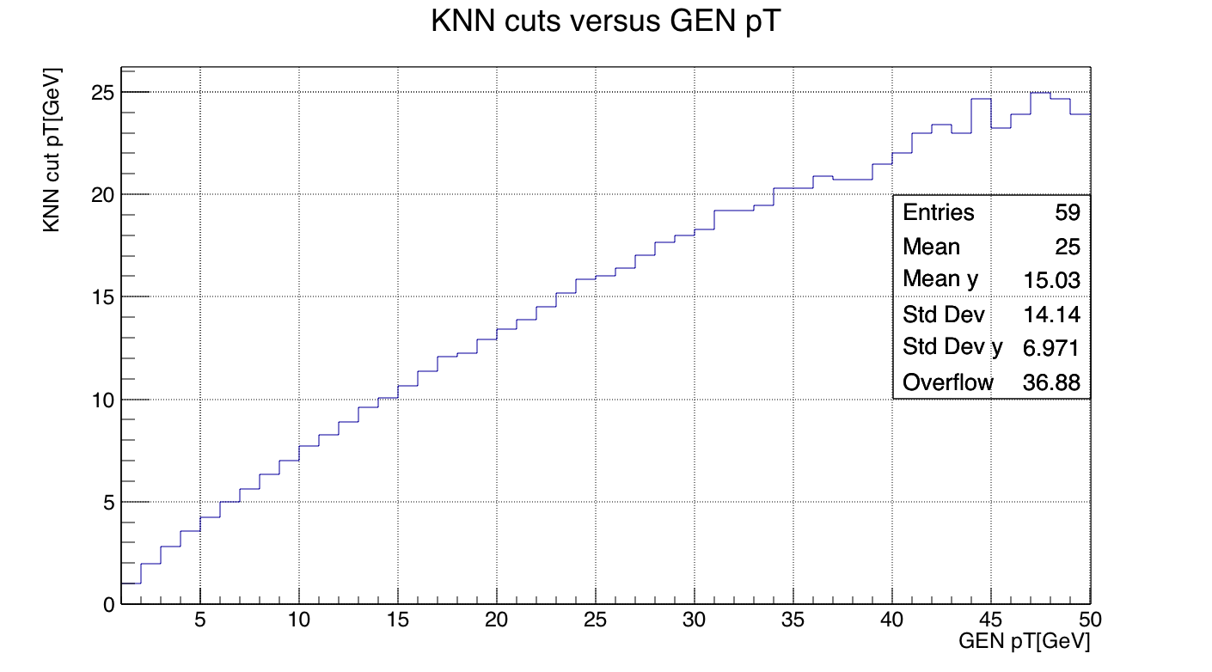
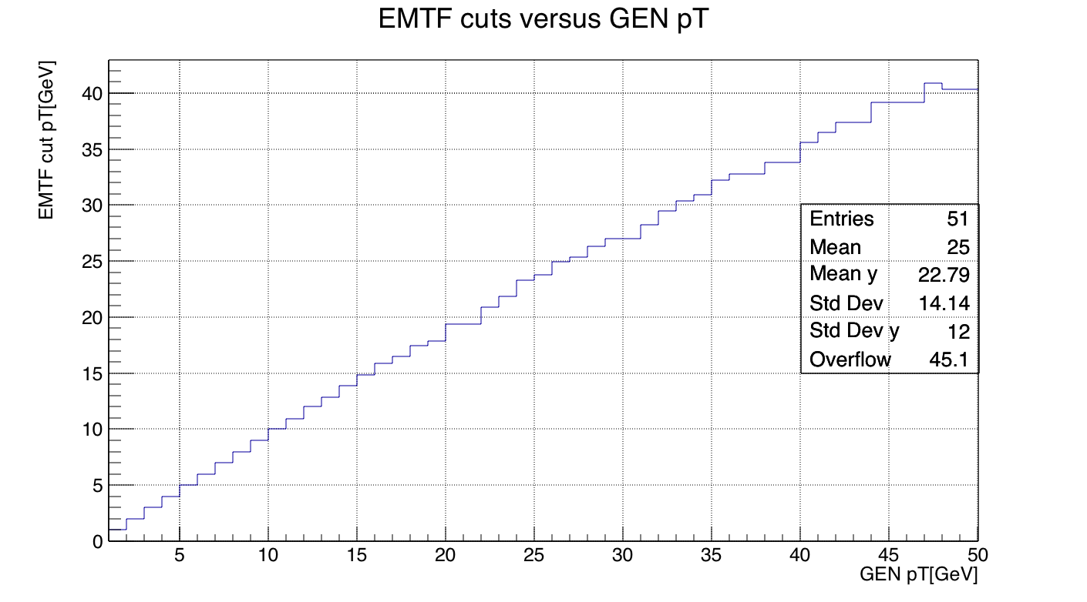
Find 90% efficiency thresholds for rate computation
KNN
EMTF
Reduce the rate for a given threshold efficiency (90% here), without significantly lowering the plateau efficiency

Slide 16
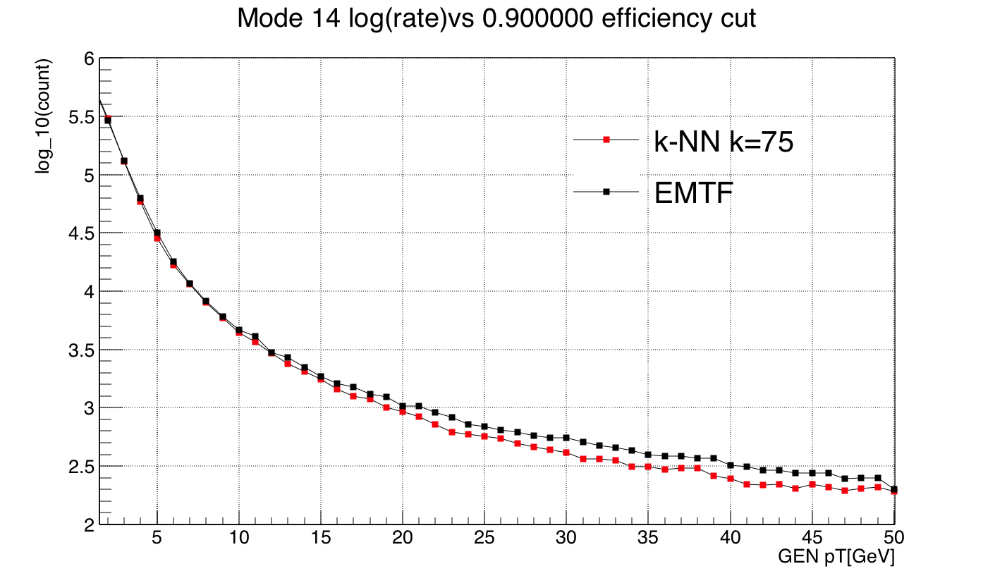
Rate @ k=75
Rate vs. pT cut at a given efficiency in ZeroBias data
For a given efficiency cut, compute the rate at various thresholds by counting ZeroBias events with pT > X

Slide 17
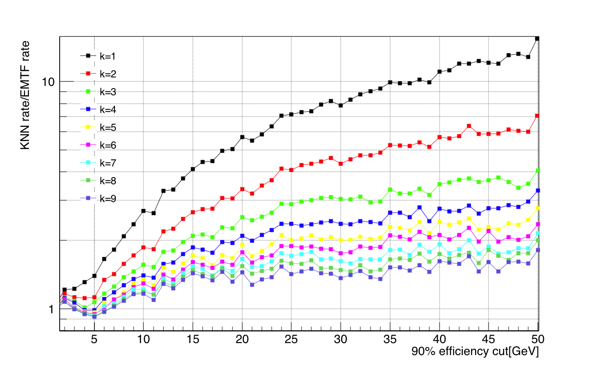
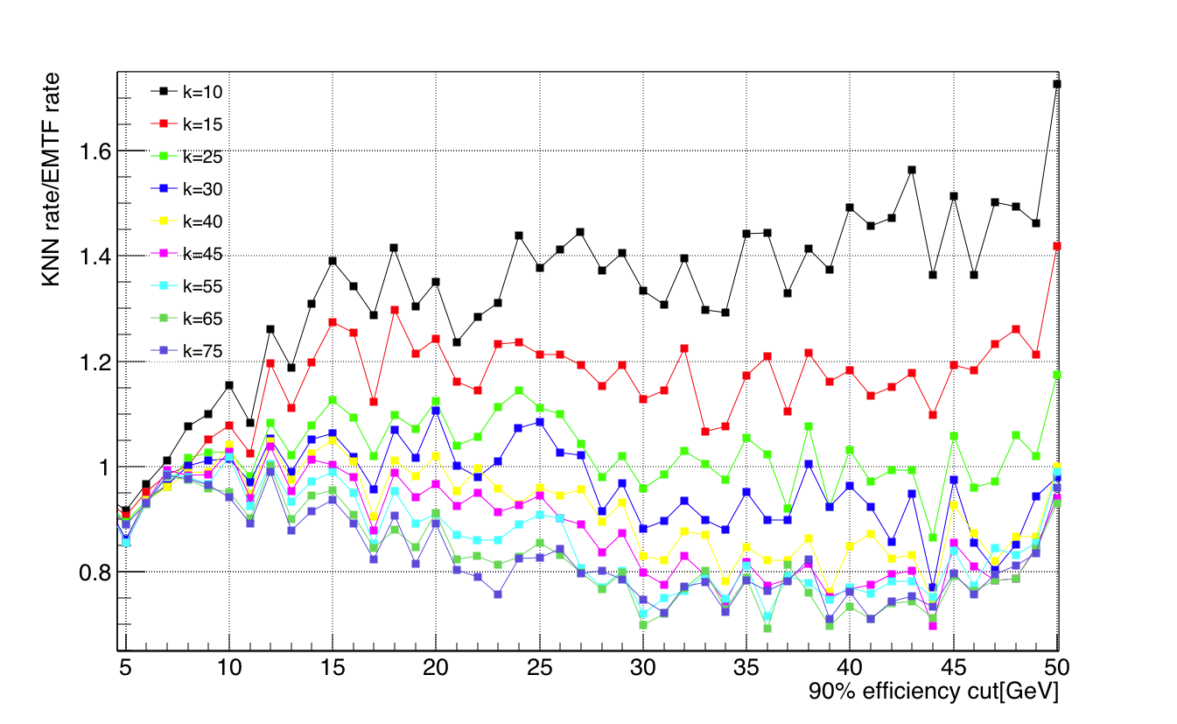
Plot ratio: k-NN rate/EMTF rate
90% efficiency cut
For k in [1, 75], performance goes better as k increases
Approximate the current EMTF at k~25
Good rate reduction performance in pT 5-50 GeV for k~75

Slide 18
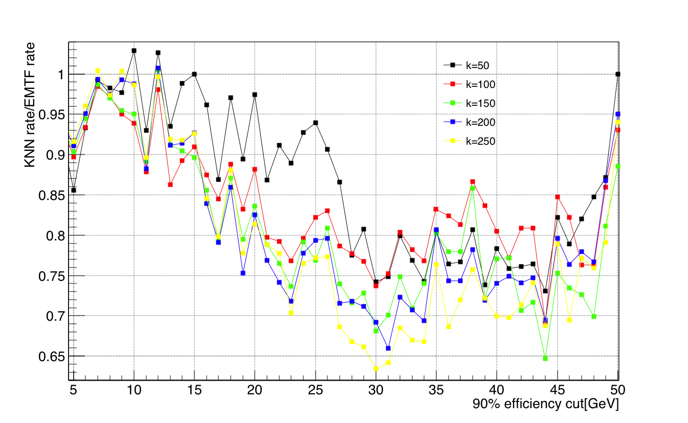
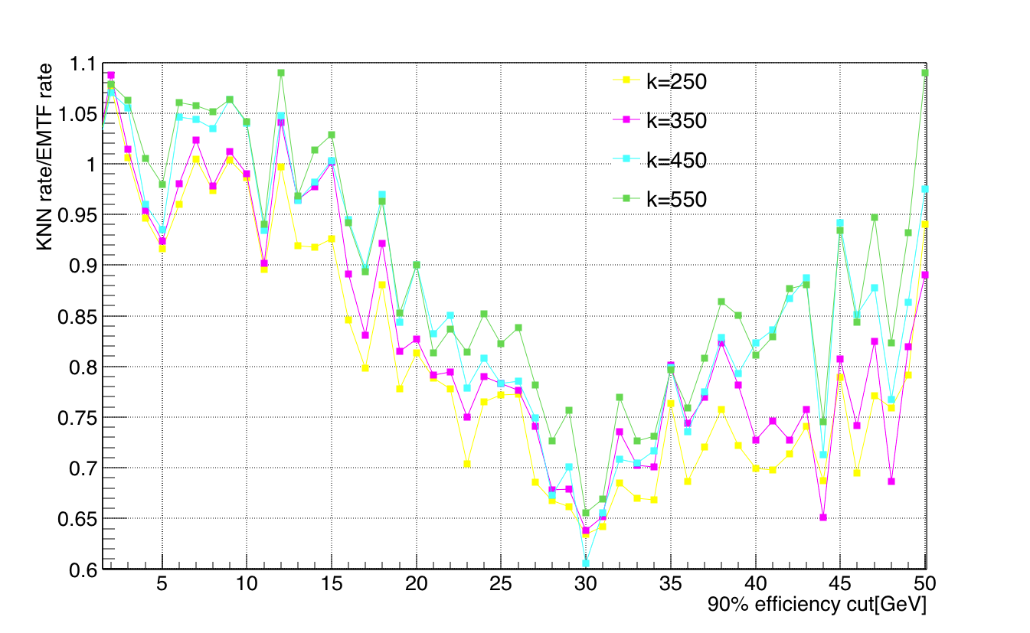
Large scan step: 50 and 100
Wide scan shows good rate reduction keeps until k~250
Start to degrade the performance as k goes from 250 to 550
A good stop at k~550, no need to go larger
Very long time for training/testing at k ~ O(10³), average running time of nearest neighbor search is O(log N)
Very large k is bad for high pT according to previous MSE results

Slide 19
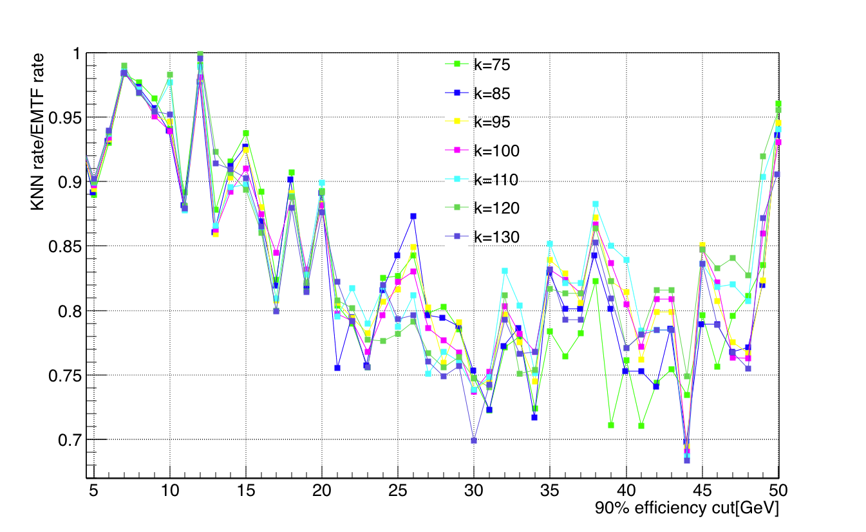
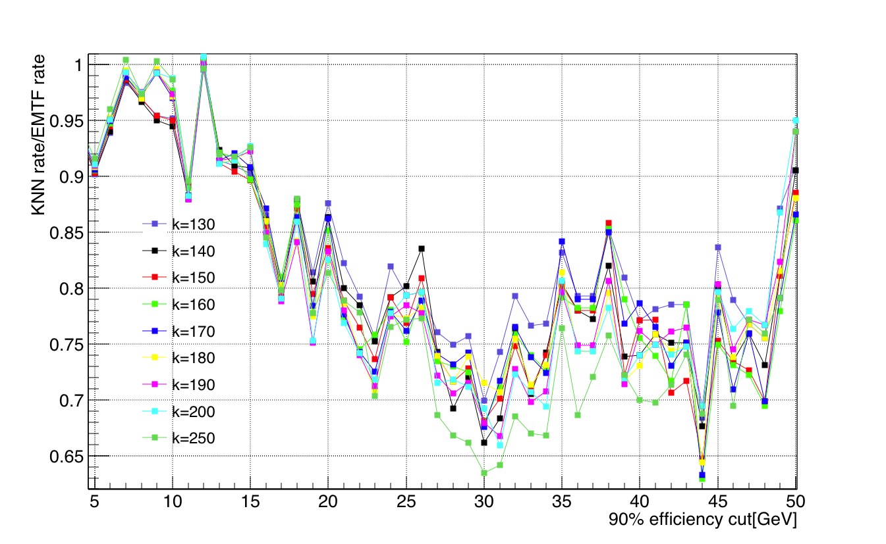
k values between 75 and 250
General trend: performance is better as k goes from 75 to 250
Best rate reduction depends on the pT cut
No significant or overall improvement on pT range 5-50 GeV
Recommend using k~75, rate reduction 15%-29% more than EMTF at pT 20-40 GeV

Slide 20
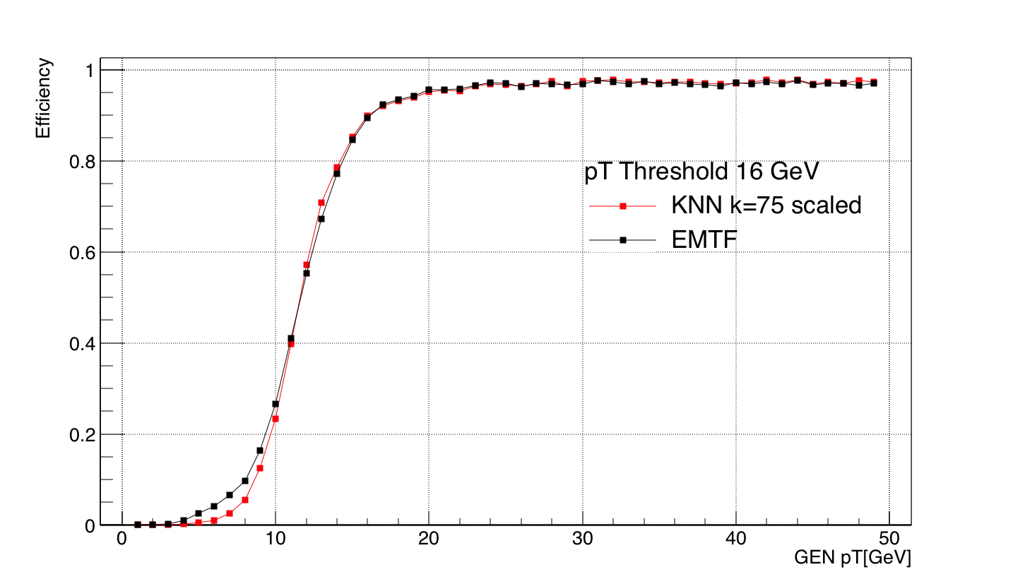
Efficiency of 16 GeV threshold at k=75
Projection from 2D scaled efficiency plot
Not scaled
k=75: 90% efficiency at 16 GeV threshold, larger than 95% for pT >>16 GeV

Slide 21
k-NN performance summary
k-NN rate reduction improves when k increases, consistent with MSE results for low pT
k-NN rate reduction starts to degrade after k~250
k = 75 is recommended for a good rate reduction for pT at 5-50 GeV
k = 75 gives acceptable efficiency
Future work:
Include RPC, truncate bits
Compare different trigger algorithms (BDT, MLP, ANN) with k-NN using the 2017 LUT variables scheme for mode 14 (add FR2, ring # in station 1, # can be 1 or 2)
Study other 3-station modes

Slide 22
BACK UP

Slide 23
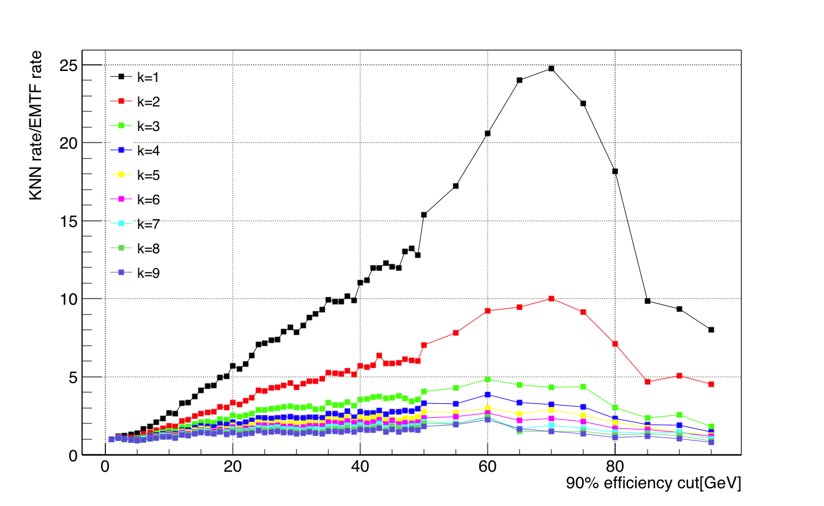
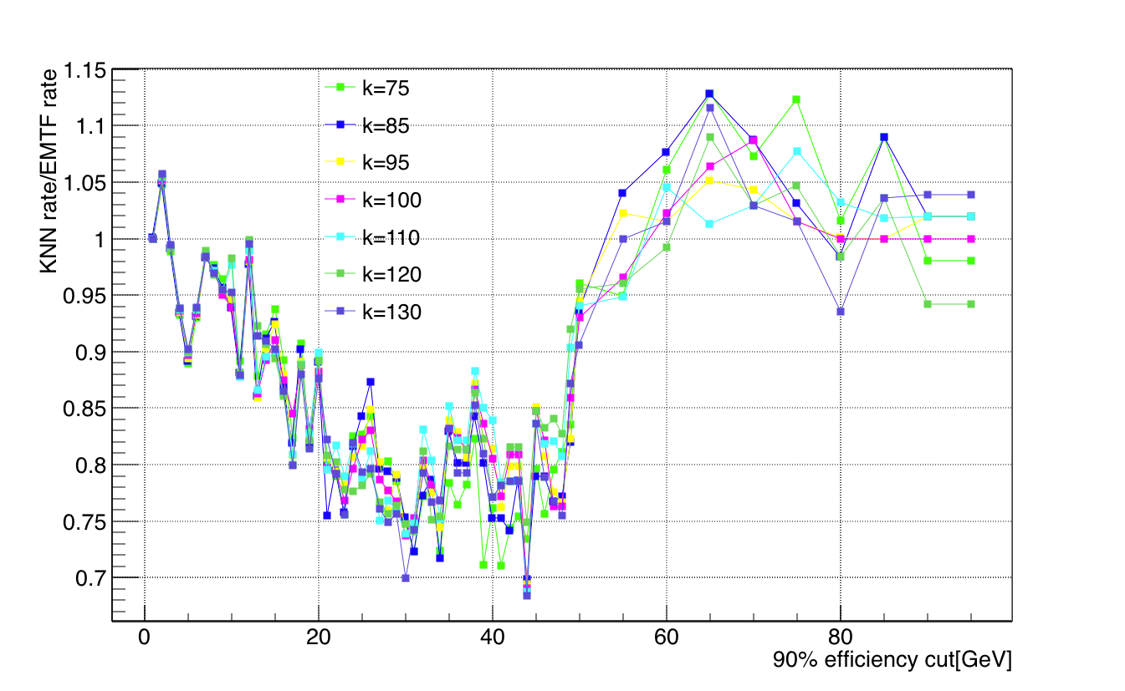
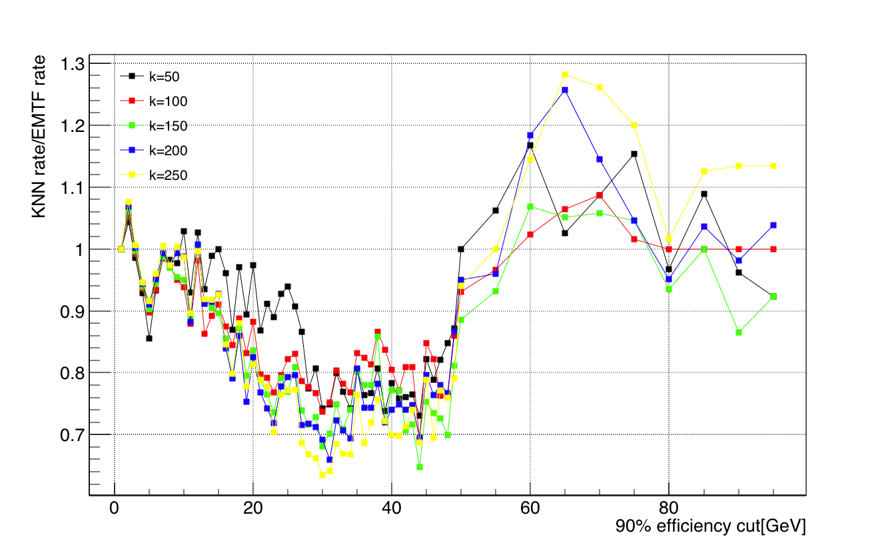
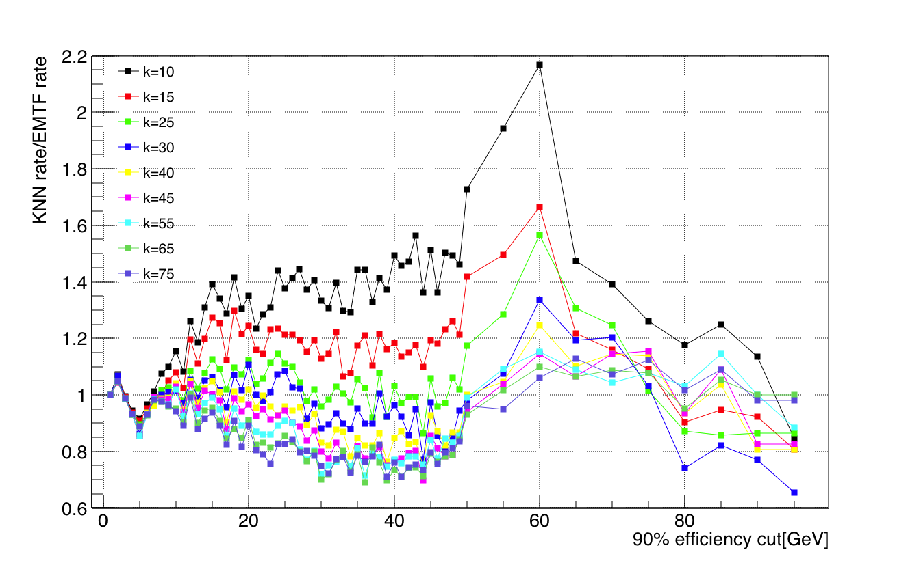
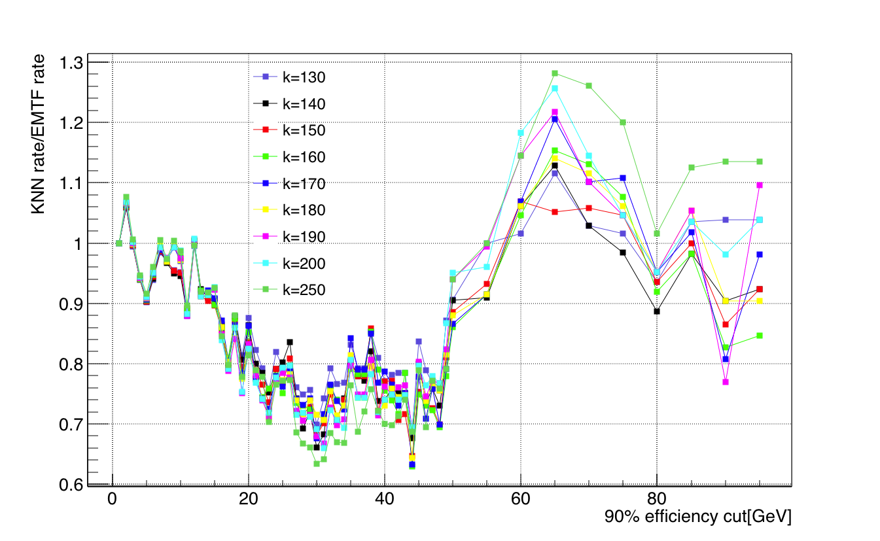
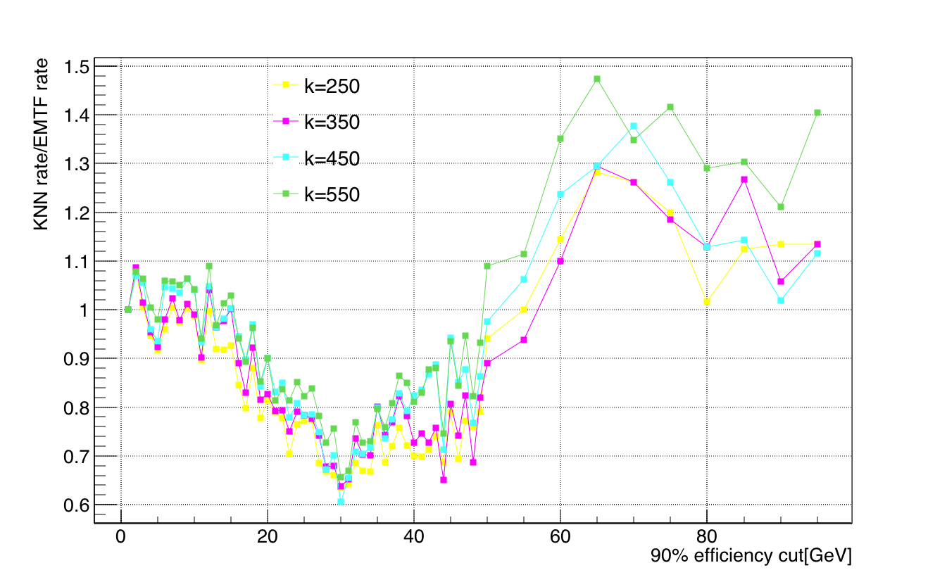
Rate tatio vs k, pT 1-99GeV

Slide 24
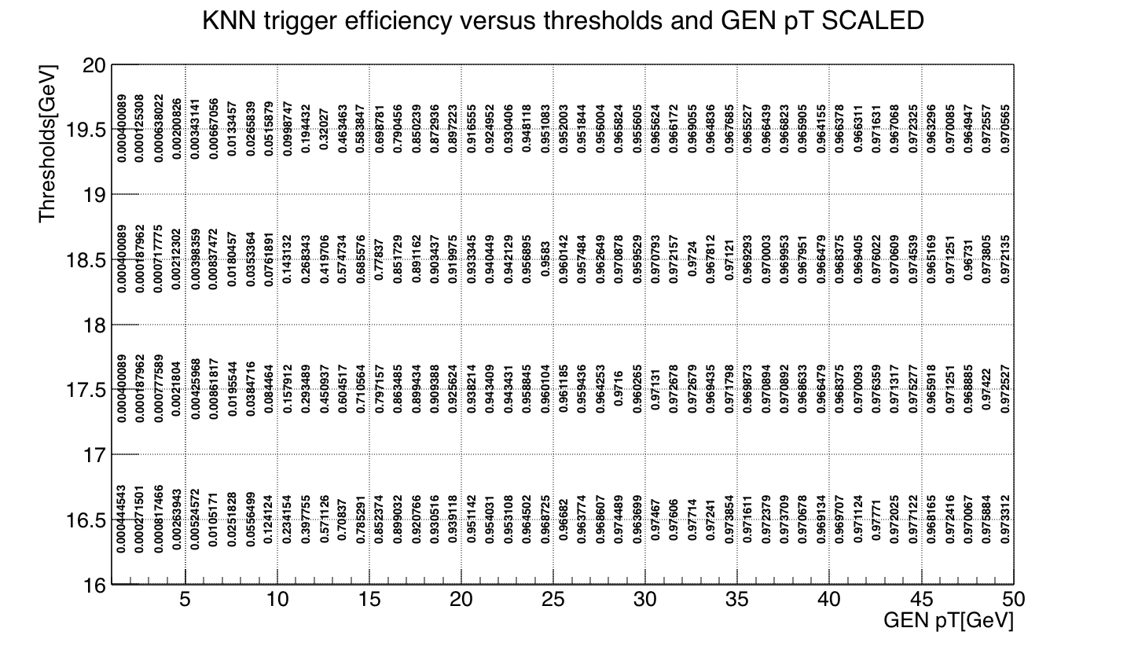
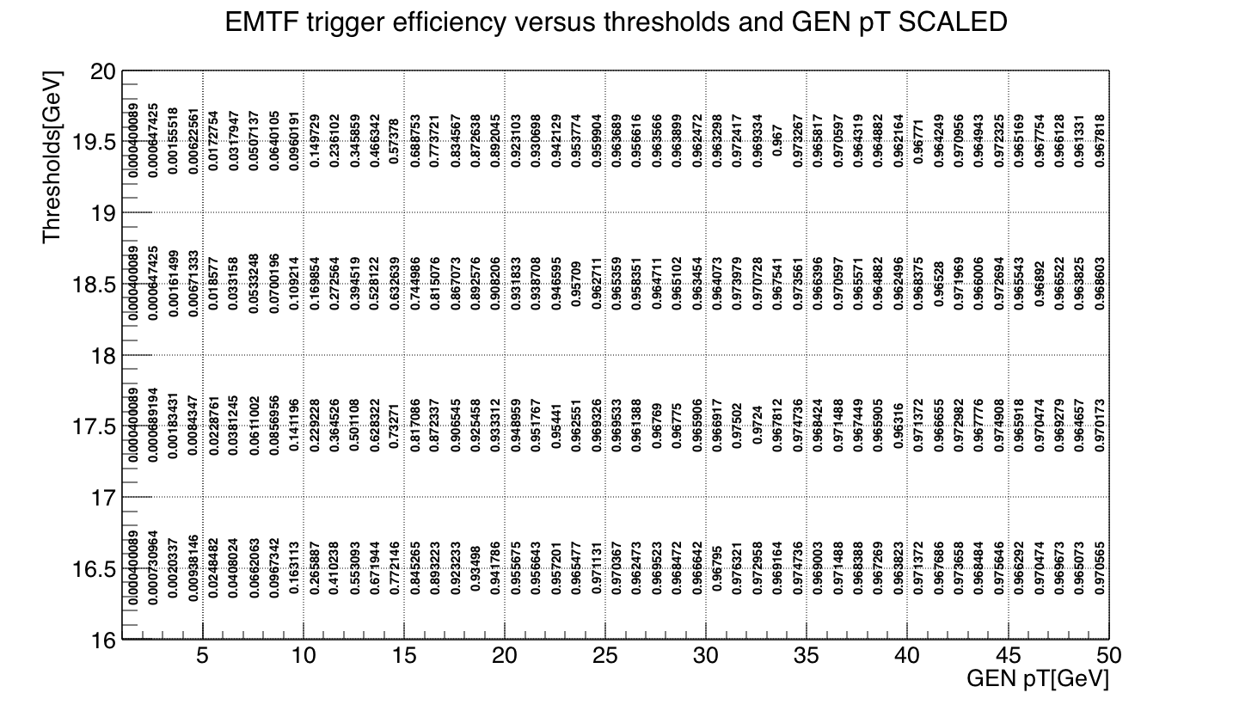
Efficiency at k=75, threshold pT 16-20 GeV

Slide 25
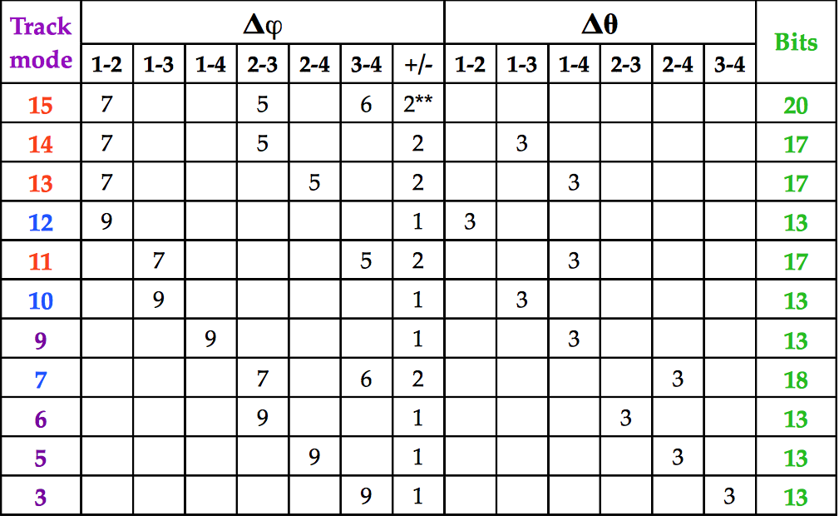
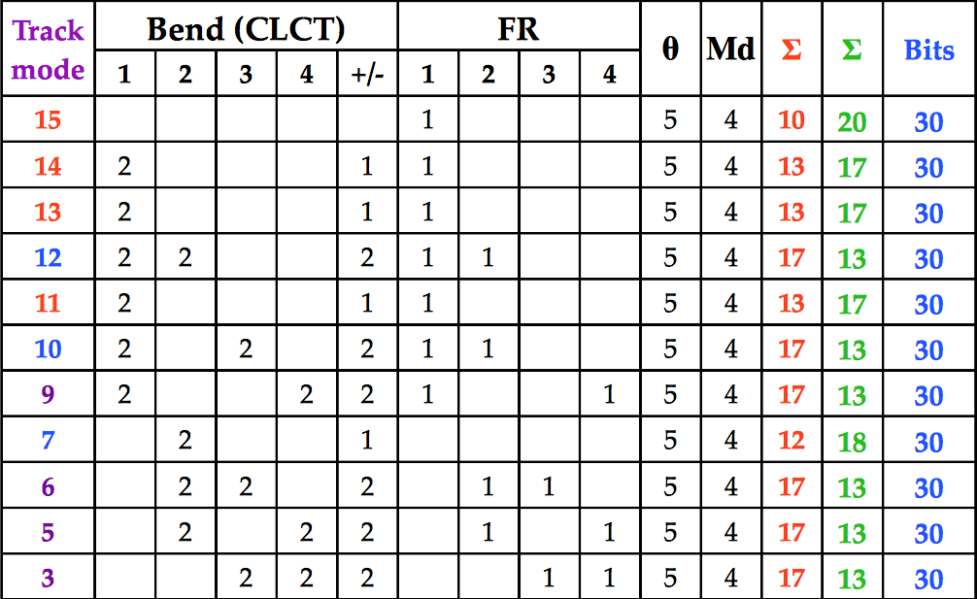
2016 pT LUT based on BDT

Slide 26
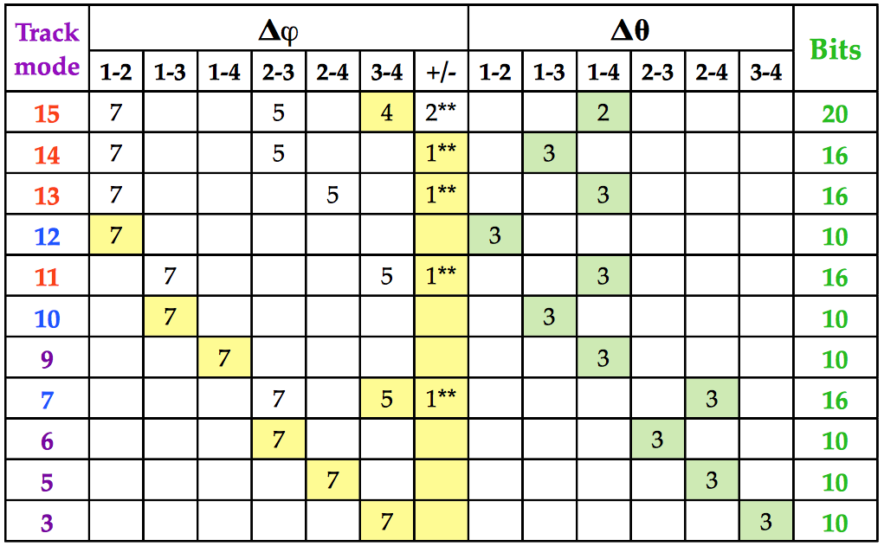
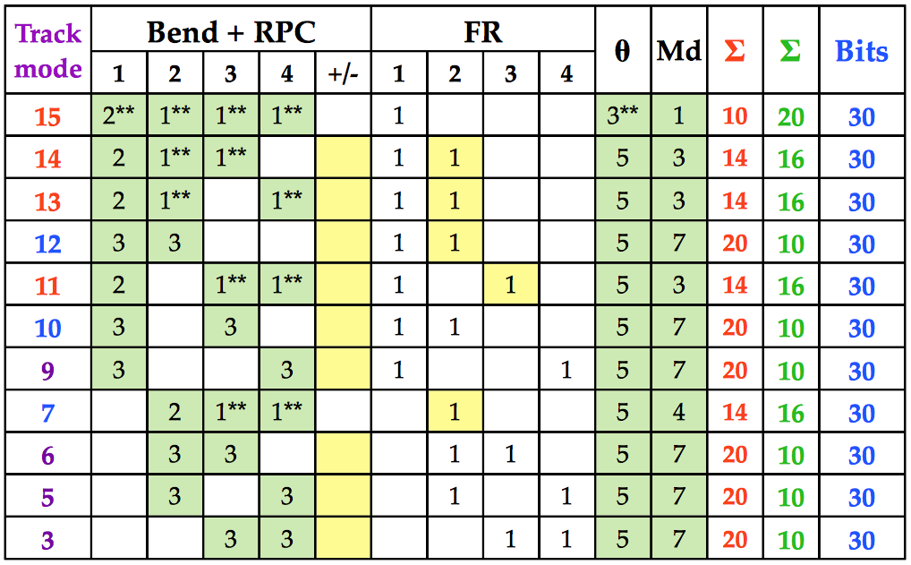
Proposed 2017 pT LUT

Slide 27
Mode 14: Station 1-2-3
Compare to last time:
Much higher statistics(10M events, mode 14 has 787858 train and 788544 test), 42 * last time: 18746 train)
2016 LUT(dPhi12, 23; theta; CLCT1; dTheta13; FR 1)(mainly tune value k)
Low/high pT divide up
Weight 1/pT(unweight not plotted yet)
Tune KNN scale frac
Doing classification instead of regression?

Slide 28
Steps
Find optimized input/target/k/scalfrac for KNN for other modes
Select the better method used for other modes: change inputs
Include RPC hits and repeat 1-3 step
Remove/truncate to fit in 29 bits
Repeat for other modes
Train charge assignment(classification)

Slide 29
kNN
Tune k and Scale frac
Continuous/categorical variable: different metric(Euclidean/Hamming)
When mixture of both kinds of variables, standardization or scale variables(called feature normalization)
E.g. x’=(x-min)/(max-min); x’= (x-x_mean)/x_variance; assign weights to d(i,j)(TMVA adopts this)
A non-parametric method Unlike other supervised learning algorithms, K-Nearest Neighbors doesn’t learn an explicit mapping f from the training data
Simply uses the training data at the test time to make predictions
Need large dataset/cross validation dataset

Slide 30
KNN Regression
For a test event, the algorithm finds the k-nearest neighbours using the input variables, where each training event contains a regression value. The predicted regression value for the test event is the weighted average of the regression values of the k-nearest neighbours
The choice of the metric governs the performance of the nearest neighbour algorithm. When input variables have different units a variable that has a wider distribution contributes with a greater weight to the Euclidean metric. This feature is compensated by rescaling the variables using a scaling fraction determined by the option ScaleFrac.

Slide 31
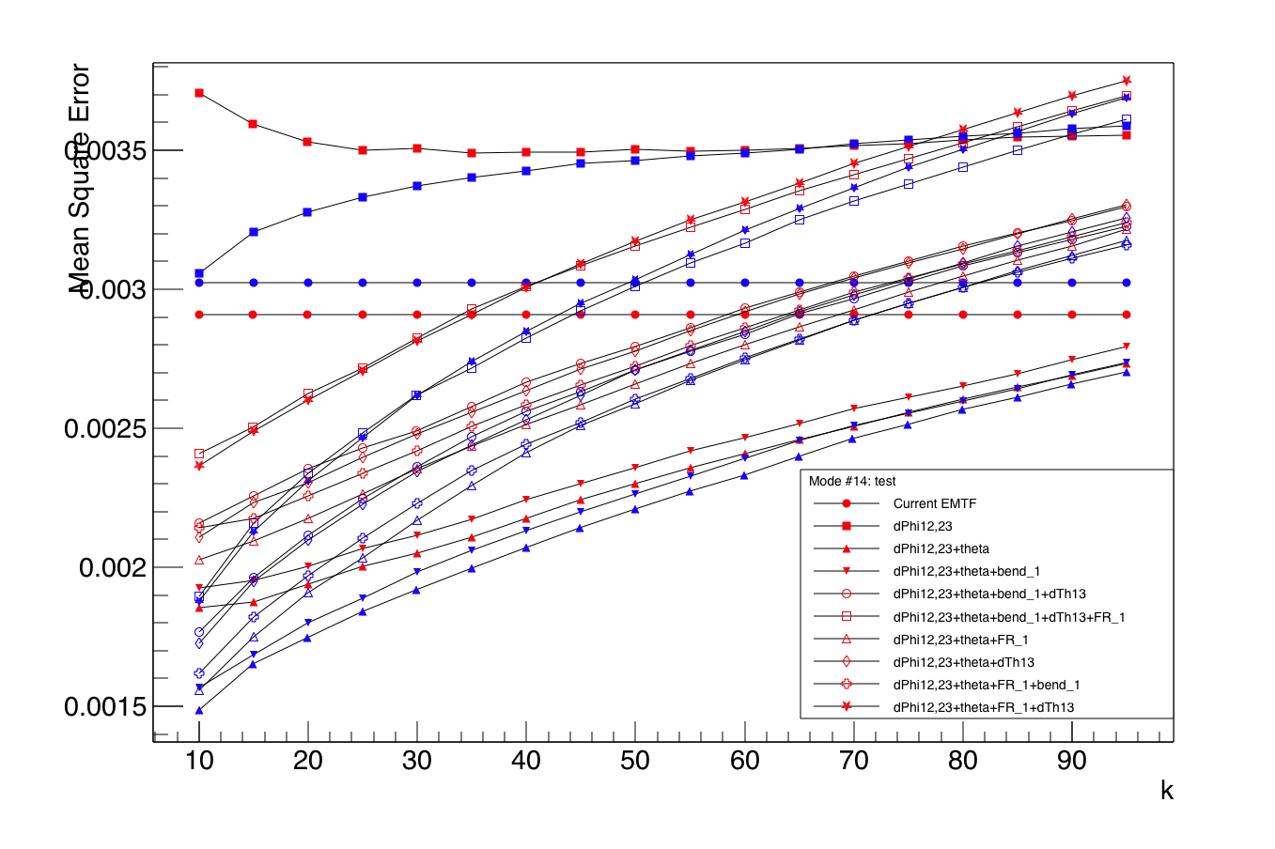

Slide 32
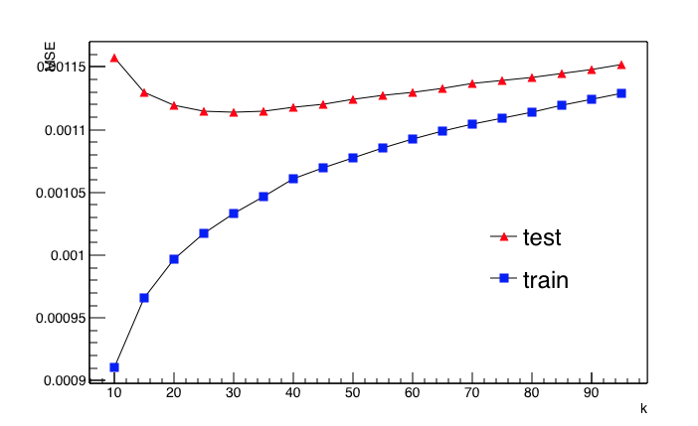
"nkNN=30:ScaleFrac=0.8:SigmaFact=1.0:Kernel=Gaus:UseKernel=F:UseWeight=T:!Trim"
Mode: 15
Input variables: dphi12, dphi23, dphi34
Target variable: 1/Gen pT
MSE = Deviation^2/N
/afs/cern.ch/work/a/abrinke1/public/EMTF/Analyzer/ntuples/EMTF_MC_NTuple_SingleMu_noRPC_300k.root

Slide 33
Comments
Maybe we don’t need to choose the best model, instead, we can use weighted models for final pT LUT
Maybe we can use different model for different input variables, some model may perform better than others in certain parameter region(eta)

Slide 34
BDT parameters(mode 15) from Andrew B.(check)
For mode 15
400 trees
Depths: 5
1/pT weight(0-120 GeV), Log2(pT) is better target than 1/pT
For very high pT, unweighted events better(>120 GeV)
Input variables: FR bits bring significant improvement at low and high pT
In addition to track theta, FR 1, and dPhi 1-2, 2-3, and 3-4(LUT v1), add combinations of dPhis, and ring number of station 1
https://indico.cern.ch/event/608207/contributions/2451751/subcontributions/218758/attachments/1402616/2142649/2017_01_26_Mode_15_BDT.pdf

Slide 35
BDT good/bad
Good: little tuning required(simple)
Bad:
will ignore non-discriminating variables as for each node splitting only the best discriminating variable is used
theoretically best performance on a given problem is generally inferior to other techniques like neural networks.
See TMVA tutorial

